Slide 1

HTML5 程式設計
INTRODUCTION OF WEB DESIGN
DE - LONG CAL

Slide 2
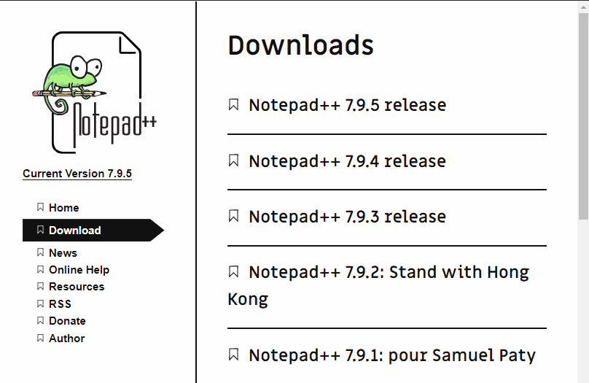
Download
• Go to the below web for your download
• https://notepad-plus-plus.org/downloads/

Slide 3
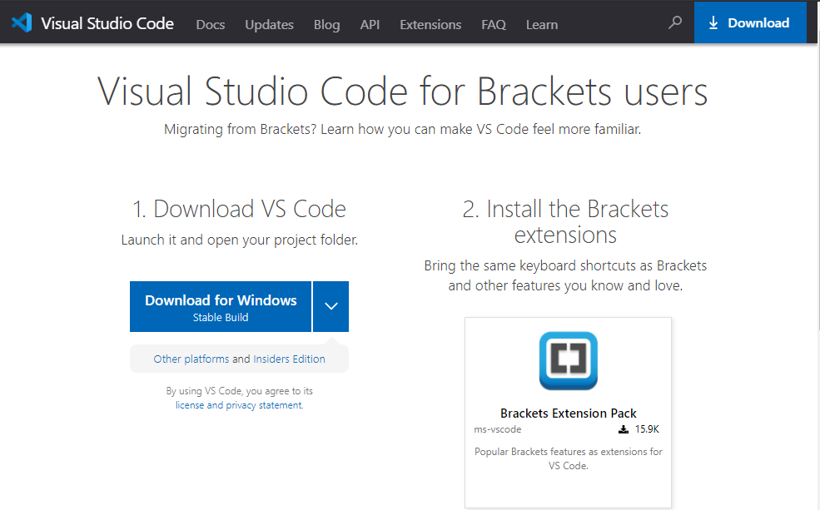
Download
• Go to the below web for your download
• https://code.visualstudio.com/migrate-from-brackets

Slide 4
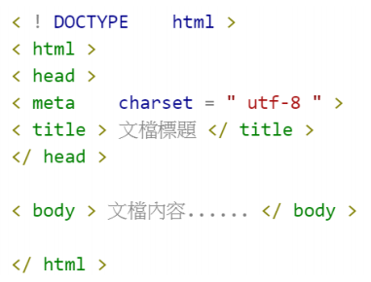
HTML5
• <!DOCTYPE> 聲明必須位於HTML5 文檔中的第一行,使用非常簡單:
• For Example:

Slide 5
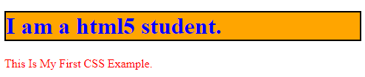
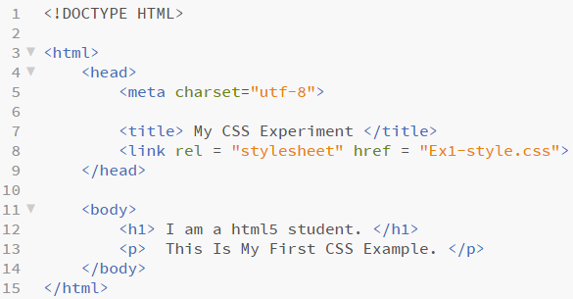
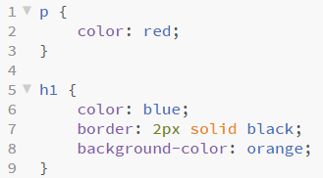
基礎 CSS 示範
Ex1.html + Ex1-style.css
Ex1.html
Ex1-style.css

Slide 6
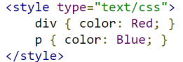
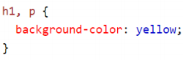
CSS Selectors
• 選擇器：Selectors
• In CSS Selectors are patterns used to select the elements you want to style.
• w3school 所定義的 Selectors：https://www.w3schools.com/cssref/css_selectors.asp
CSS 設定於 HTML 檔案中，將樣式套用於指定元素。
(b) CSS 設定於 HTML 使用不同檔案。

Slide 7
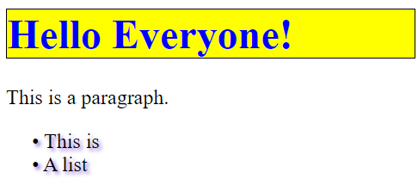
Exercise
• 參考：https://goo.gl/Ebjdo9 CSS 參考手冊
Ex2.html + Ex2-style.css

Slide 8
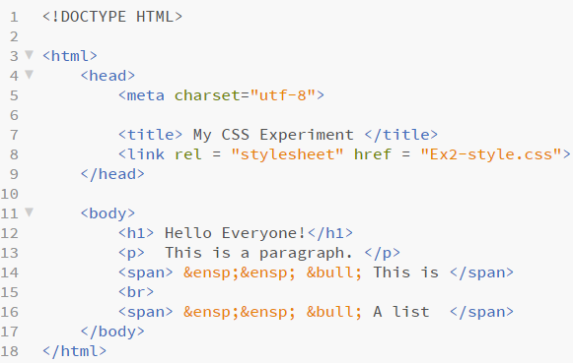
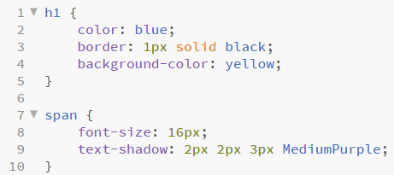
Answer
Ex2.html
Ex2-style.css

Slide 9
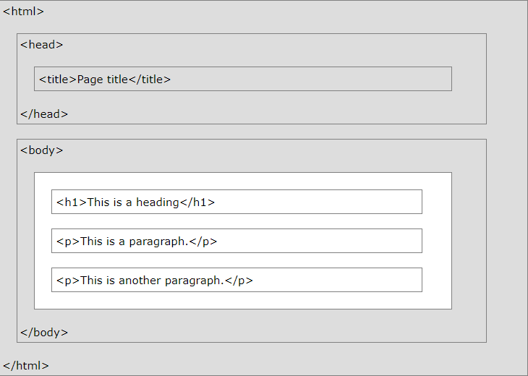
HTML Page Structure
• Below is a visualization of an HTML Page Structure：
• Note：Only the content inside the <body> section is displayed in a browser.
HTML Versions
Year | Version
1991 | HTML
1995 | HTML 2.0
1997 | HTML 3.2
1999 | HTML 4.01
2000 | XHTML
2014 | HTML 5

Slide 10
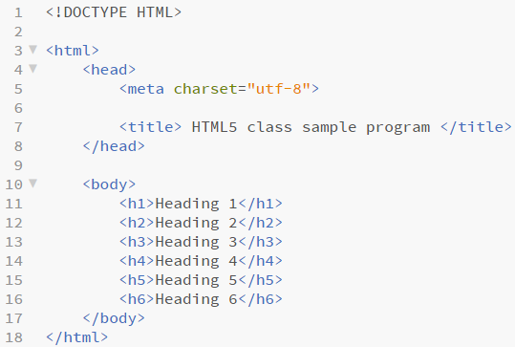
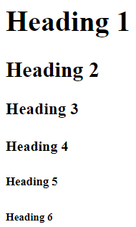
Code it
Ex3.html

Slide 11
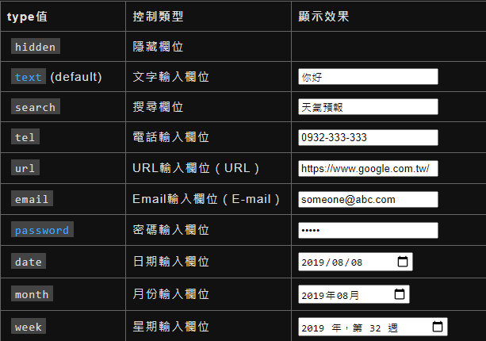
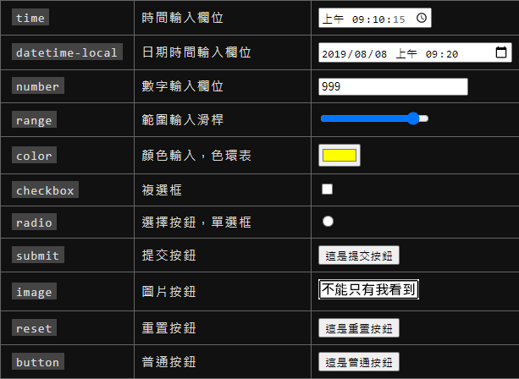
HTML Input Types
• Here are the different input types you can use in HTML：

Slide 12
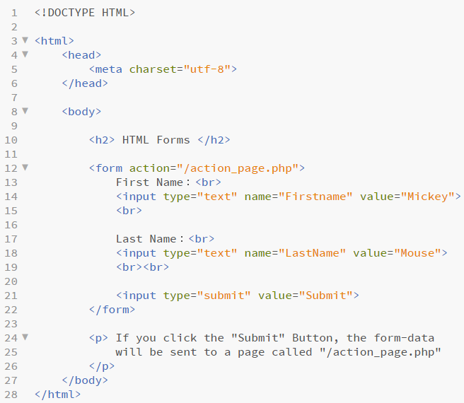
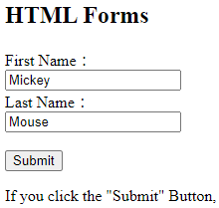
Code it
Ex4.html

Slide 13
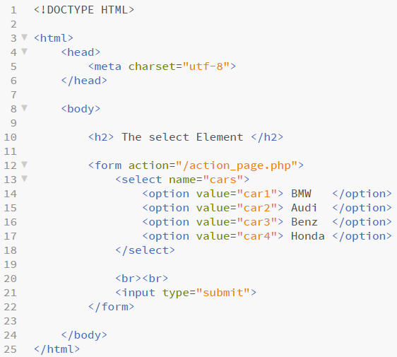
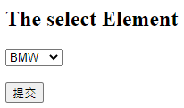
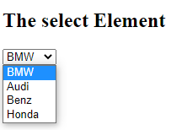
The <select> Element
執行 1
執行 2
Ex5.html

Slide 14
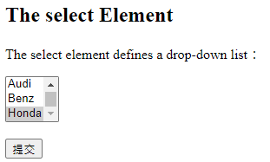
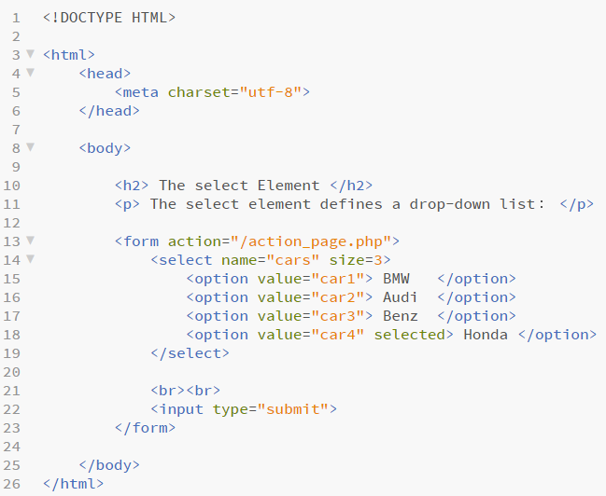
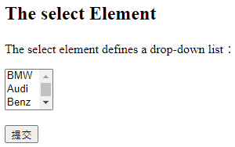
Visible Values
執行 1
執行 2
Ex6.html

Slide 15
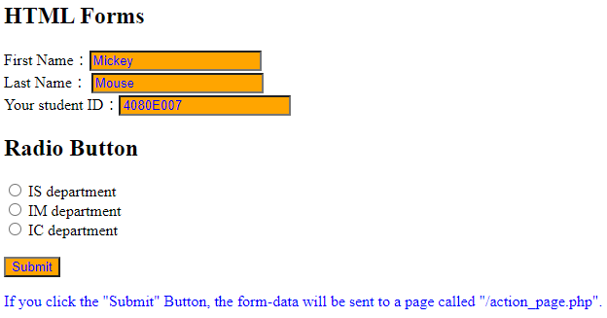
Radio Button
• Exercise
Ex7.html + Ex7-style.css

Slide 16
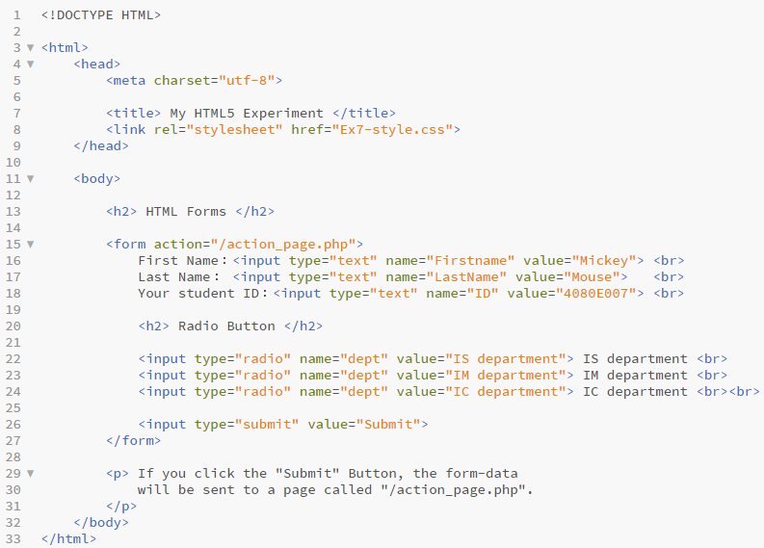
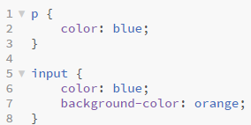
Radio Button
Ex7-style.css
Ex7.html

Slide 17
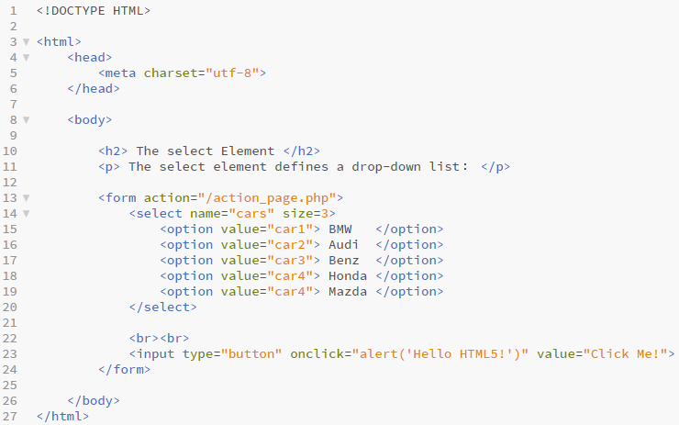
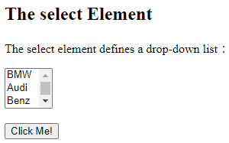
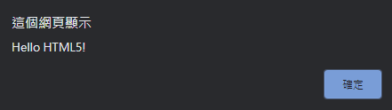
Alert action
Ex8.html

Slide 18
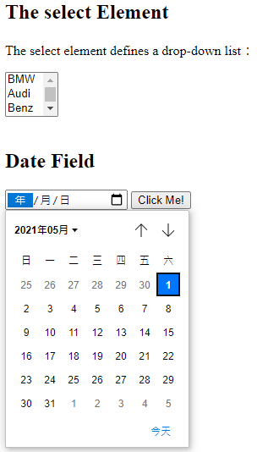
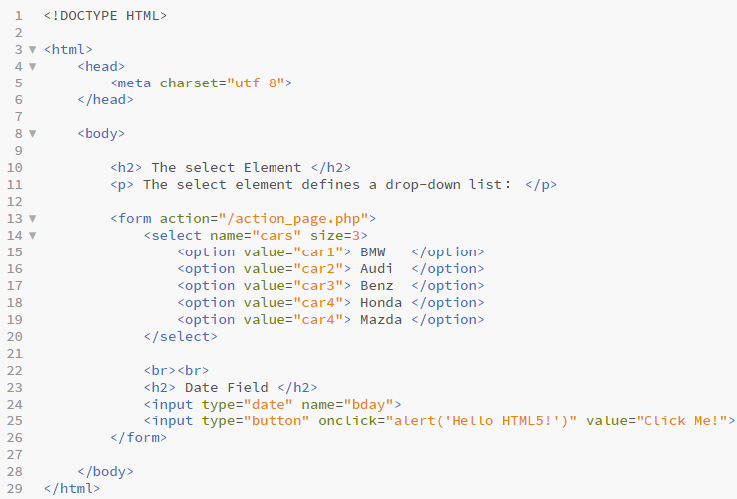
Date type
Ex9.html

Slide 19
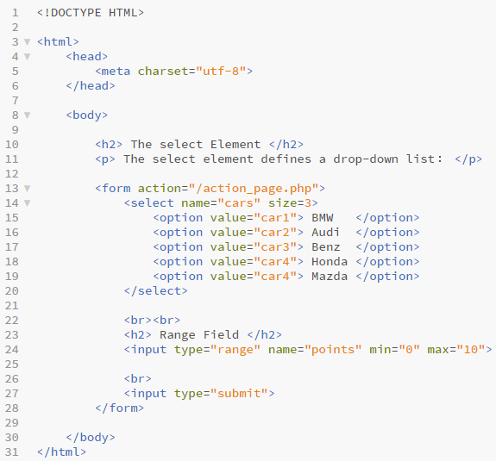
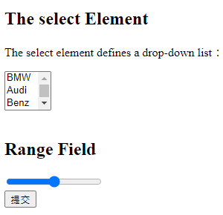
Range
Ex10.html

Slide 20
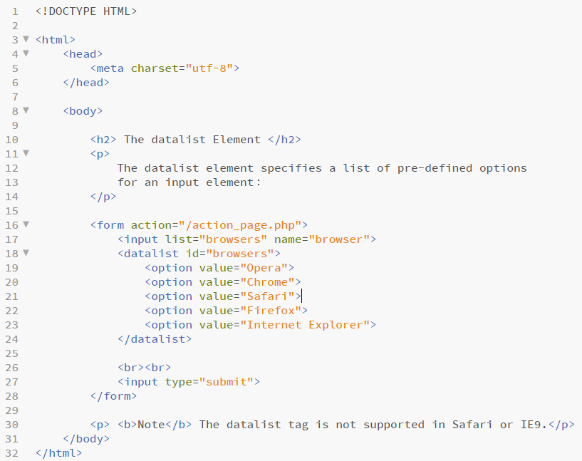
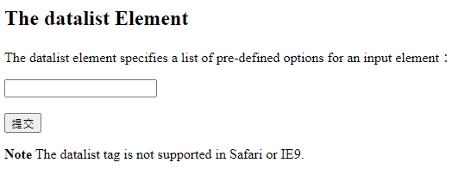
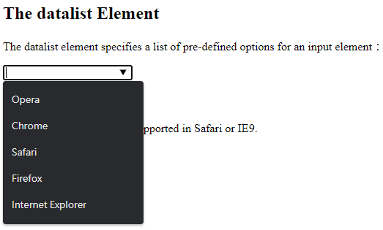
<datalist> Element
執行 1
執行 2
Ex11.html

Slide 21
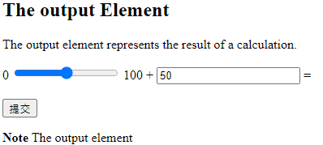
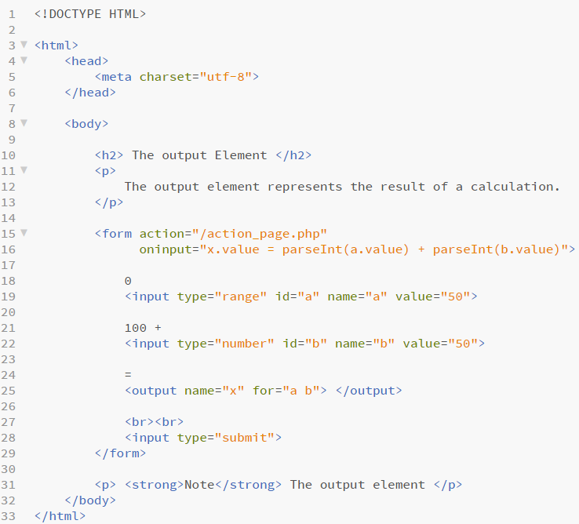
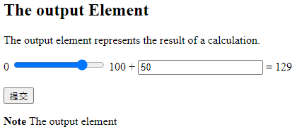
<input> + <output> Element
執行 1
執行 2
Ex12.html

Slide 22
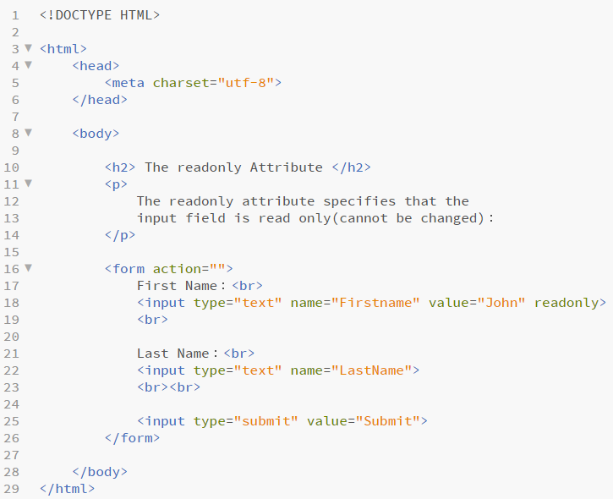
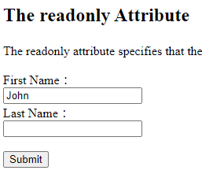
Attribute：readonly
Ex13.html

Slide 23
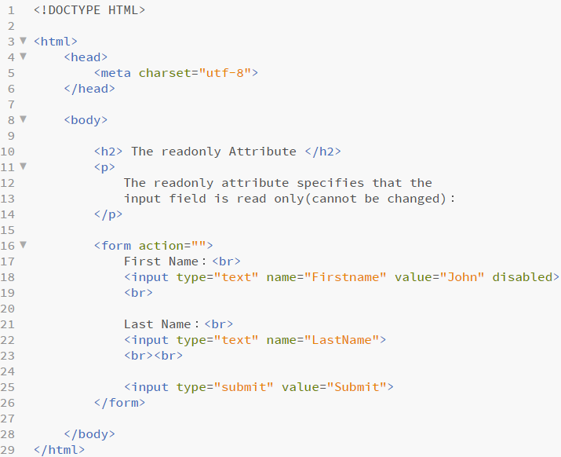
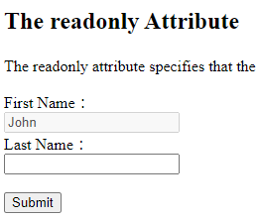
Attribute：disabled
Ex14.html

Slide 24
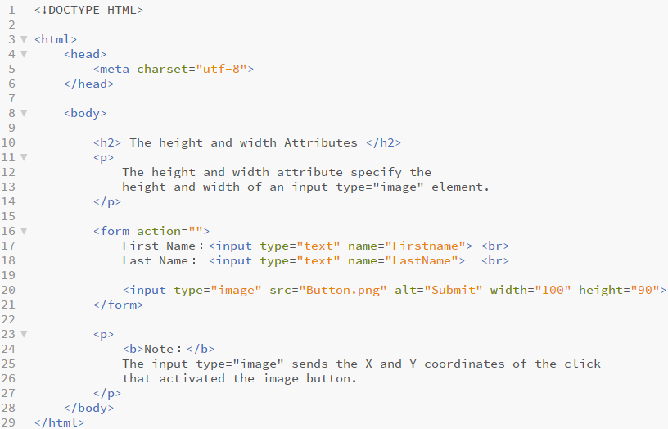
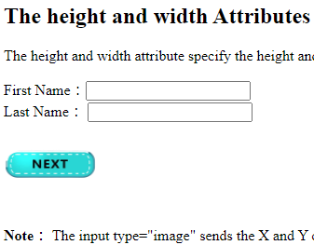
Attribute：height & width
Ex15.html

Slide 25
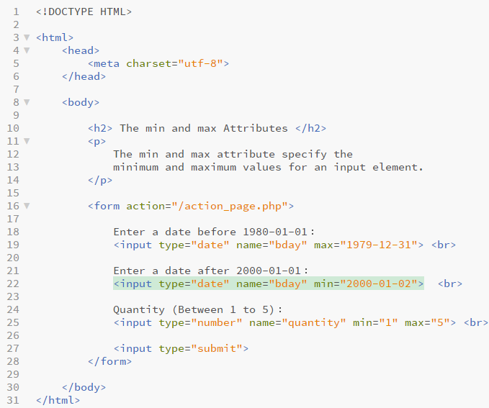
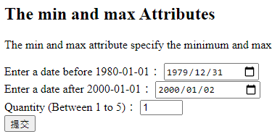
Attribute：min & max
Ex16.html

Slide 26
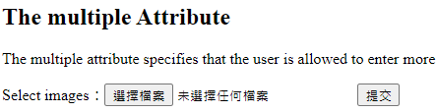
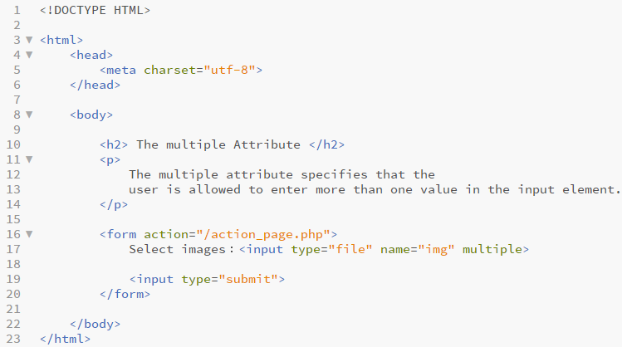

Attribute：multiple
Ex17.html

Slide 27




Attribute：pattern
Ex18.html

Slide 28



<img>
Ex19.html

Slide 29


Image Size
Ex20.html

Slide 30




Image Maps
• Exercise

Slide 31


Image Maps
• Answer
Ex21.html

Slide 32


Background Image in <body>
Ex22.html

Slide 33


Image Floating
Ex23.html

Slide 34


Background Image in <p>
Ex24.html

Slide 35


<table>
Ex25.html

Slide 36


Adding a Border
• If you do not specify a border for the table,
it will be displayed without borders. Namely, this is a default setting.
• A border is set using the css border property：
Ex26.html

Slide 37


Adding a Border
• If you do not specify a border for the table, it will be displayed without borders.
• A border is set using the css border property.
• CSS border-collapse 屬性的功能是用來將表格欄位邊框合併，讓表格變得更美化
Ex27.html

Slide 38


Adding a Border
Ex28.html

Slide 39

Adding a Border
• Exercise
• How about the rows spanned below?
Ex29.html

Slide 40


Adding a Border
Ex29.html

Slide 41


Adding a Caption
Ex30.html

Slide 42

Using table name
& background color
Ex31.html

Slide 43



Different colors
Ex32.html

Slide 44


The css settings in way 2
Ex33.html

Slide 45


The element Selector
• The element selector selects elements
based on the element name.
• You can select all <p> elements
on a page like this (in this case,
all <p> elements will be center-aligned,
with a red texr color)：
Ex34.html

Slide 46



The id Selector
Ex35.html

Slide 47


The class Selector
• The class selector selects elements
with a specific class attribute.
• To select elements with a specific class,
write a period (.) character,
followed by the name of the class.
• In the example below,
all HTML elements with
class=“center” will be red
and center-aligned：
Ex36.html

Slide 48


Extra (補充)
Ex37.html

Slide 49


Extra (補充)
Ex38.html

Slide 50


Grouping Selectors
• The you have elements with the same style definitions
• It will be better to group the selectors, to minimize the code.
• To group selectors, separate each selector with a comma.
Ex39.html

Slide 51


CSS Box Model
Explanation of the different parts:
• Content - The content of the box, where text and images appear
• Padding - Clears an area around the content. The padding is transparent
• Border - A border that goes around the padding and content
• Margin - Clears an area outside the border. The margin is transparent
• The CSS Box Model

Slide 52


CSS margins
• All the margin properties can have the following values:
auto - the browser calculates the margin
Length - specifies a margin in px, pt, cm, etc.
% - specifies a margin in % of the width
of the containing element.
inherit - specifies that the margin should be inherited from the parent element.
Ex40.html

Slide 53


Margin - The Inherit Value
Ex41.html

Slide 54


CSS Fonts
• Font Family: The font family of a text is
set with the fontfamily property.
• The font-family property should hold several
font names as a “fallback” system.
If the browser does not support the first font,
it tries the next font, and so on.
• Note: If the name of a font family is more
than one word, it must be in quotation marks,
like: "Times New Roman".
• More than one font family is specified in
a commaseparated list：
Ex42.html

Slide 55



Show layout without float
Ex43.html

Slide 56

Show layout with float
Ex44.html

Slide 57

Exercise
• The following layout is in the middle of your browser.
• Below colors are your choices.
Ex45.html

Slide 58


Answer
Ex45.html

Slide 59


Complex Landscape
Ex46.html

Slide 60


Complex Landscape
Ex47.html

Slide 61


Complex Landscape
Ex48.html

Slide 62

Complex Landscape
• Exercise
Ex49.html
Ex49.html

Slide 63



Complex Landscape
• Answer
Ex49.html

Slide 64

Complex Landscape
Ex50.html

Slide 65




Complex Landscape
Ex50.html

Slide 66


Complex Landscape
Ex50.html

Slide 67



Example
• Exercise
• Answer
Ex51.html

Slide 68


Example
• Answer
Ex51.html

Slide 69


Box-shadow effect
• The box-shadow CSS property
adds shadow effects around an
element's frame
Ex52.html

Slide 70


Box-shadow effect
• The box-shadow CSS property
adds shadow effects around an
element's frame
Ex53.html

Slide 71


Box-shadow effect
• The box-shadow CSS property
adds shadow effects around an
element's frame
Ex54.html

Slide 72


Box-shadow effect
• The box-shadow CSS property
adds shadow effects around an
element's frame
Ex55.html

Slide 73


Box-shadow effect
• The box-shadow CSS property
adds shadow effects around an
element's frame
Ex56.html

Slide 74


Box-shadow effect
• The box-shadow CSS property
adds shadow effects around an
element's frame
Ex57.html

Slide 75



Border Effect
Ex58.html

Slide 76


Transform：translate
Ex59.html

Slide 77





Exercise
Ex60.html

Slide 78



Card Flip
Ex61.html

Slide 79


Card Flip
Ex61.html

Slide 80




Fade in Overlay
Ex62.html

Slide 81


Fade in Overlay
Ex62.html

Slide 82





Exercise
Ex63.html

Slide 83



Exercise
Ex64.html

Slide 84


Exercise
Ex65.html

Slide 85


Exercise
Ex66.html

Slide 86
The End

